Slide 1
Performance Assessments for Understanding
System Learning Day
Friday, March 8, 2013

Slide 2
The Petting Zoo

Slide 3
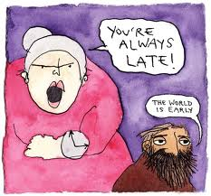
Circle of Viewpoints
A routine for exploring diverse perspectives
Brainstorm a list of different perspectives and then use this script skeleton to explore each one:
I am thinking of ... the topic... From the point of view of ... the viewpoint you've chosen
I think ... describe the topic from your viewpoint. Be an actor - take on the character of your viewpoint
A question I have from this viewpoint is ... ask a question from this viewpoint
Wrap up: What new ideas do you have about the topic that you didn't have before? What new questions do you have?
Source: Visible Thinking – Project Zero, Harvard Education
http://www.old-pz.gse.harvard.edu/vt/VisibleThinking_html_files/03_ThinkingRoutines/03e_FairnessRoutines/CircleViewpoints/CircleViewpoints_Routine.html

Slide 4
Where do performance tasks fit within a unit design?
Please refer to the AAC (Alberta Assessment Consortium) Key Visual
In pairs or table groups, please consider where performance assessments fit within the cycle of teaching and learning.
Be prepared to share your ideas with the whole group.

Slide 6
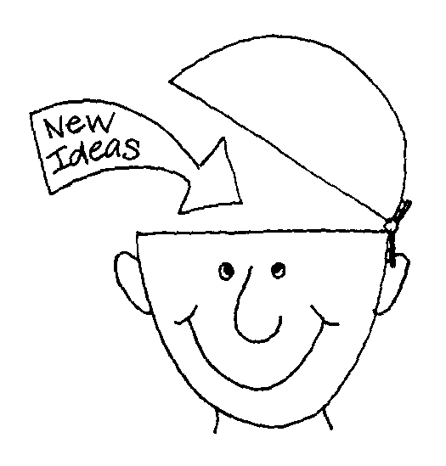
Authentic Performance – A necessity, not a frill
“Understanding is revealed in performance. Understanding is revealed as transferability of core ideas, knowledge, and skill, on challenging tasks in a variety of contexts. Thus, assessment for understanding must be grounded in authentic performance-based tasks.”
Source: Wiggins & McTighe. (2005). Understanding by Design (2nd Edition)

Slide 7
Assessment requires…
Constructing an assessment always involves these basic principles:
Specify clearly and exactly what it is you want to assess
Design tasks or test items that require students to demonstrate this knowledge or skill
Decide what you will take as evidence of the degree to which students have shown this knowledge and skill
Adapted from: Brookhart, Susan. (2010). How to assess higher-order thinking skills in your classroom.

Slide 8
Assessing Higher-Order Thinking
Assessing higher-order thinking almost always involves three additional principles:
Present something for students to think about, usually in the form of introductory text, visuals, scenarios, resource materials, or problems of some sort.
Use novel material – material that is new to the student, not covered in class and thus subject to recall.
Distinguish between level of difficulty (easy versus hard) and level of thinking (lower-order thinking or recall versus higher-order thinking), and control for each separately.
Source: Brookhart, Susan. (2010). How to assess higher-order thinking skills in your classroom.

Slide 9
Ask yourself…
How would I (the student) have to think to answer this question or do this task?
… to determine the thinking skills required
What would I (the student) have to think about to answer the question or do the task?
… to determine the content knowledge required
Both should match the knowledge and skills the assessment is intended to tap.

Slide 10
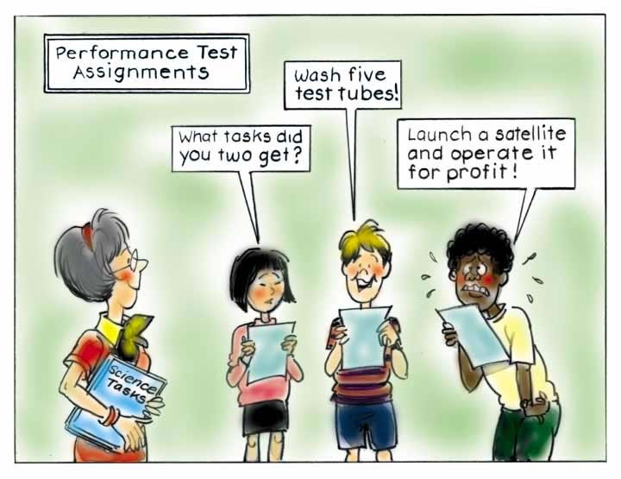

Slide 11
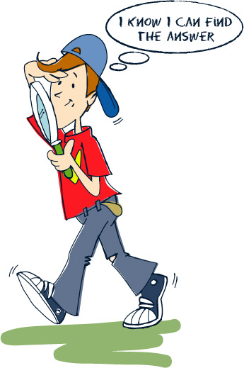
Features of Performance Assessments
“Performance assessments – including various kinds of papers and projects – require students to make or do something more extended than answering a test question, and can assess higher-order thinking, especially if they ask students to support their choices or thesis, explain their reasoning, or show their work (Brookhart, 2010, p. 25)”

Slide 12
Features of Performance Tasks
Complex challenges that mirror the issues and problems faced by adults
Ranges in length from short-term tasks to long-term, multi-staged projects
Yields one or more tangible products and performances
Involve a real world or simulated setting and the kind of constraints, background “noise”, incentives, and opportunities an adult would find in a similar situation (ie. they are authentic)

Slide 13
Features of Performance Tasks
Typically require the student to address an identified audience (real or simulated)
Are based on a specific purpose that relates to the audience
Allows students greater opportunity to personalize the task
The task, evaluative criteria, and performance standards are known in advance and guide student work
Source: Wiggins & McTighe. (2005). Understanding by Design (2nd Edition), p. 153

Slide 14
Vignettes set the stage
Notes:
“From the mountains to the seashore (history, geography; grades 6 – 8). A group of nine foreign students is visiting your school for one month as part of an international exchange program. Don’t worry, they speak English! The principal has asked your class to plan and budget a four-day tour of Alberta to help the visitors understand the province’s impact on the history and development of our country. Plan your tour so that the visitors are shown sites that best capture the ways that Alberta has influenced our nation’s development. Your task is to prepare a written tour itinerary, including an explanation of why each site was selected. Include a map tracing the route for the four-day tour and a budget for the trip.”

Slide 15
Vignettes set the stage
“From the mountains to the seashore (history, geography; grades 6 – 8). A group of nine foreign students is visiting your school for one month as part of an international exchange program. Don’t worry, they speak English! The principal has asked your class to plan and budget a four-day tour of Alberta to help the visitors understand the province’s impact on the history and development of our country. Plan your tour so that the visitors are shown sites that best capture the ways that Alberta has influenced our nation’s development. Your task is to prepare a written tour itinerary, including an explanation of why each site was selected. Include a map tracing the route for the four-day tour and a budget for the trip.”

Slide 16
Three-ring Audit Process
What concepts should be students be familiar with
Worth Being Familiar With
Important to Know and Do
What important knowledge and skills must students have for mastery
Anchors the unit; Why is this topic worth studying
Enduring Understanding
Wiggins, G. and McTighe, J. (1998). Understanding by Design. Alexandria, VA: Association for Supervision and Curriculum Development

Slide 17
Three-ring Audit Process Assessments
Traditional quizzes or tests
Worth Being Familiar With
Important to Know and Do
Constructed or selected responses
Authentic performance tasks and projects
Enduring Understanding
Wiggins, G. and McTighe, J. (1998). Understanding by Design. Alexandria, VA: Association for Supervision and Curriculum Development

Slide 18
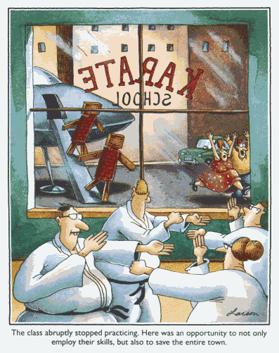

Slide 19
Tools for the Trade
Moodle Site: Performance Assessment Resource Site
http://moodle.fsd38.ab.ca/LMS/course/view.php?id=784
AAC Performance Task Template
FSD Teacher Portfolio
AAC Performance Task Resources:
Login: fsd38
Password: evaluation
Two-Question Validity Test (p. 6)
Recognizing a complex performance task (p. 7)
Human brainpower and the pleasure of our group!

Slide 20
Design, Evaluate, Modify
Choose an area of focus and work on designing a performance task using the examples and ideas generated through our discussion.
We will be coming back together to debrief and share our progress. Be prepared to address the following:
- success!
- challenges
- remaining questions

Slide 21
Exit Ticket
Connect: What connections were you able to make today to your prior knowledge and experience?
Extend: Did anything extend your thinking today?
Challenge: What challenged you today?
Free voice! What other comments or feedback are you willing to share about your experience this afternoon.

Slide 22
Thank you for your hard work!

