Slide 1
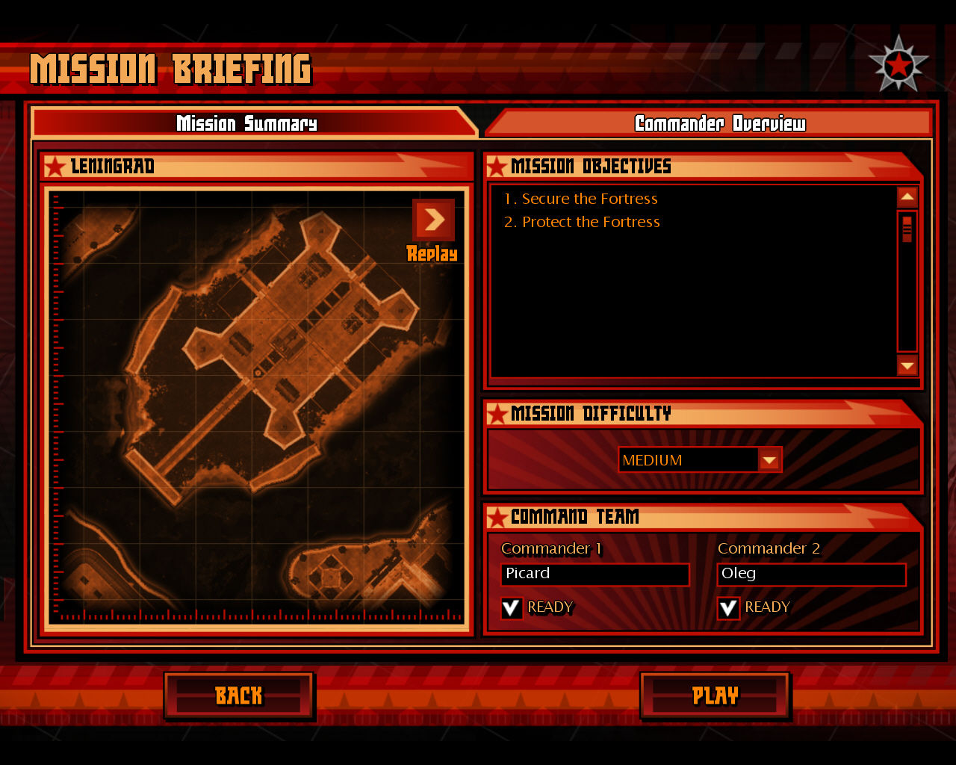
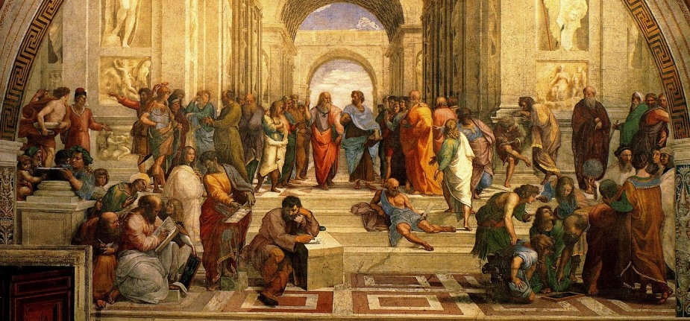
Mission Summary
Background
The 3 R’s
Visual Summary
The Black Death was the darkest moment of the Dark Ages. The people of Europe decided it was time for a change. They looked back to their glorious past as Romans with hopes of recreating it. Old books, now called classics, became their instruction manuals. Could they do it? Could they finally break out of the darkness?
Essential Question
What was the Renaissance and how did it start?
Notes:
Build my own? Use vid clip and VO? I LIKE IT.

Slide 2
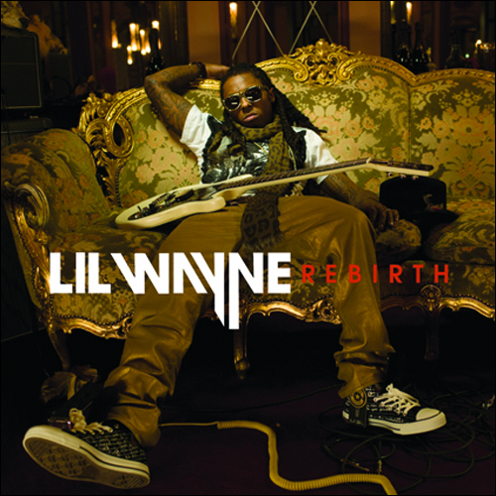
Loading...
Loading...
Loading...
Loading...
Loading...
Loading...
Loading...
Renaissance is a French word meaning rebirth.

Slide 3
Department of Timeline Security Training Module Information Codes
Mission Critical: STOP and review - this information should be copied exactly.
Informative: SLOW down and read the info. Then, shorten it and write it in your own words.
Bonus: GO on without writing, this is bonus information.

Slide 4
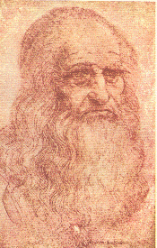
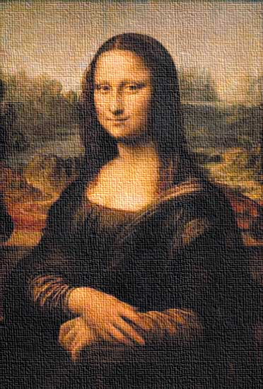
The Three Rs

Slide 5
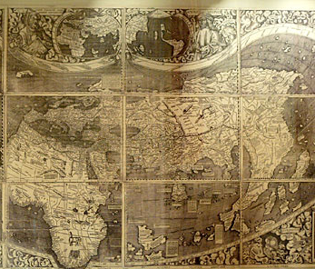
Chapter 1: The Renaissance

Slide 6
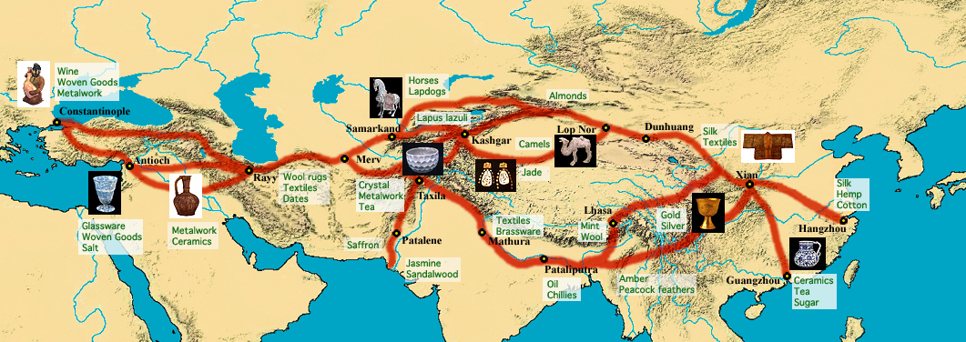
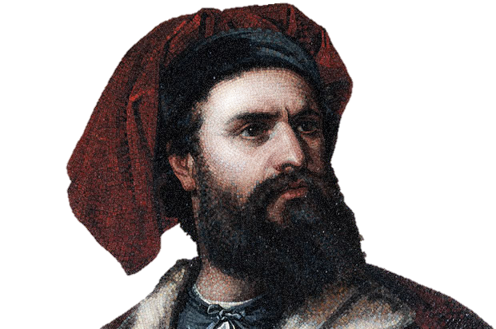
Marco Polo
When the Mongols took over China they reopened the Silk Road.
This allowed Europe to trade with China.
Marco Polo traveled this road (maybe…) and brought back many items and stories.
These gave Europeans new ideas about the world

Slide 7
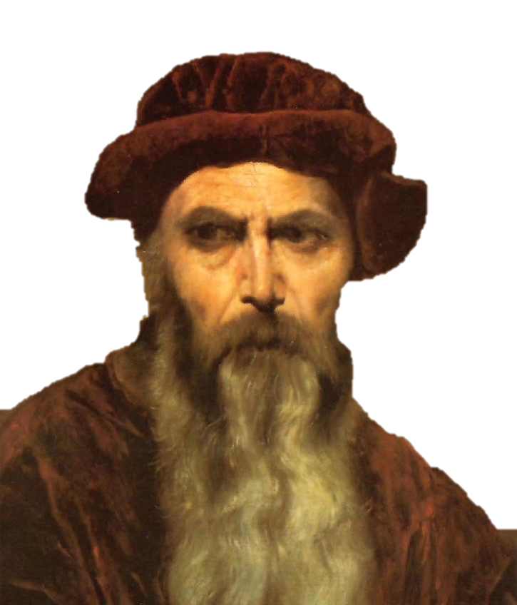
The Printing Press by Johannes Gutenburg
-A device to more easily make copies.
-Spread reading to the common people since books became much cheaper.
-The church lost its control of knowledge. (why?)

Slide 8
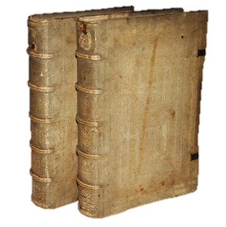
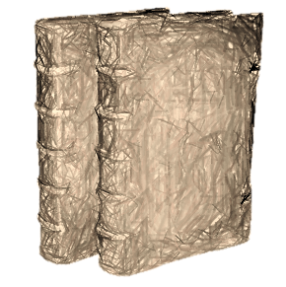
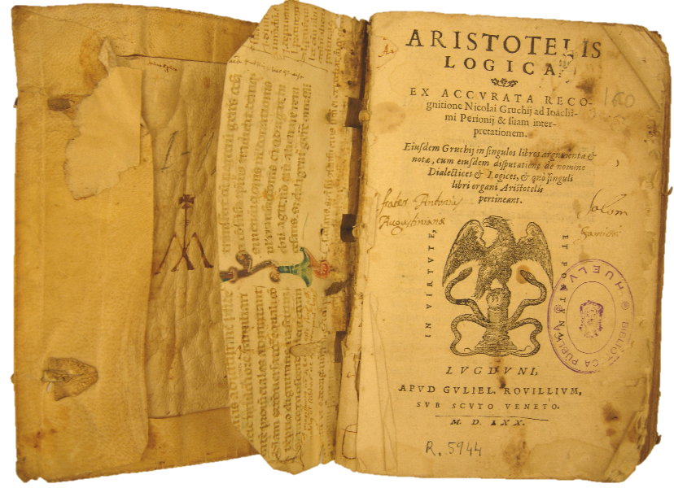
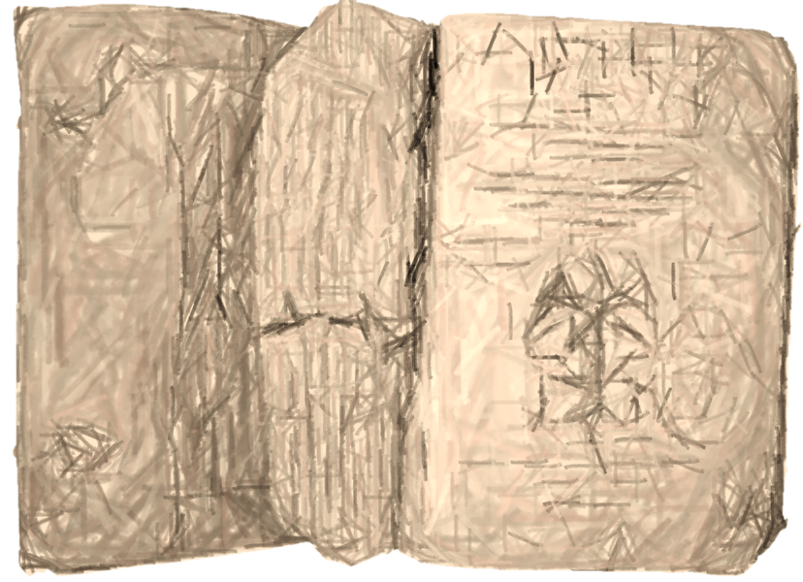
Humanism
The study of man’s ability to improve the quality of life on Earth through studying the classics.
Heaven is cool but (classics) old books can teach us stuff too!
It is ok to enjoy life on Earth.
Education and art mattered again!

Slide 9
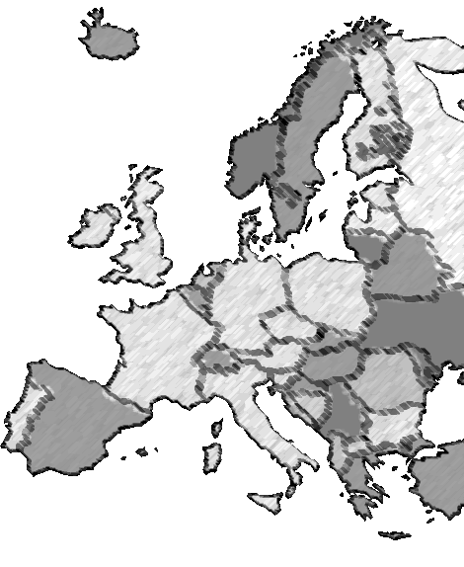
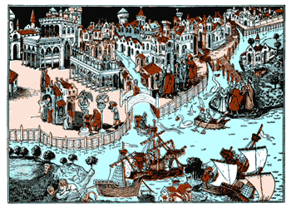
Florence
Italy’s location on the sea meant it had lots of travelers (travelers bring ideas!)
The Renaissance started in Florence, Italy and spread north.
Florence
Also had the benefit of roads left over from the Roman Empire.

Slide 10
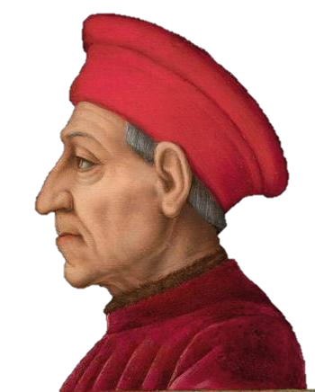
The Medicis
-A family of bankers who ruled Florence.
-They paid many artists during the Renaissance.
-Without them, the Renaissance may not have happened.
-But it wasn’t all good…

Slide 11
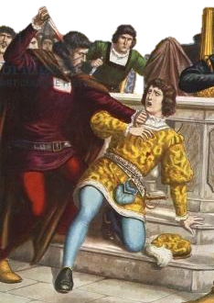
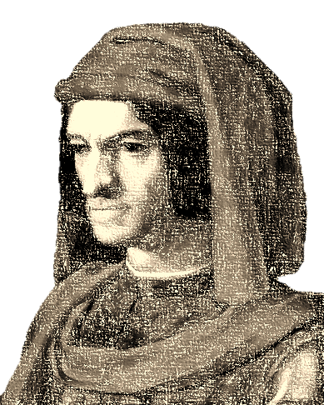
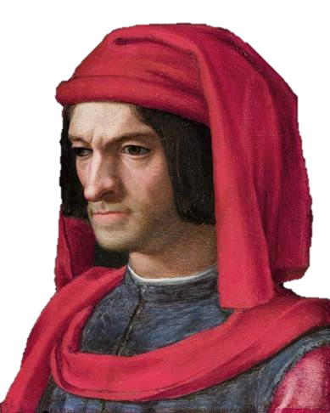
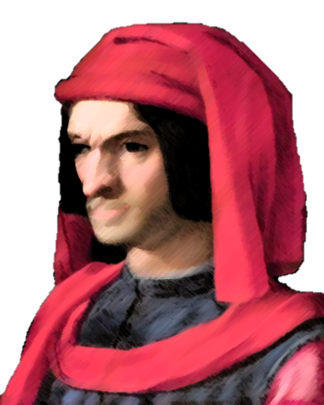
Lorenzo di Medici
-Became leader of Florence at the age of 20 after his father died.
-Patron (supporter) of Da Vinci and Michelangelo.
-Rival families saw him as weak and tried to kill him.

Slide 12
Ch2
Artists –
Michelangelo
Da Vinci

