Slide 1
Pop art
Art 21

Slide 2
The Emergence of Pop Art
britain
usa
Mid 1950s
Late 1950S

Slide 3
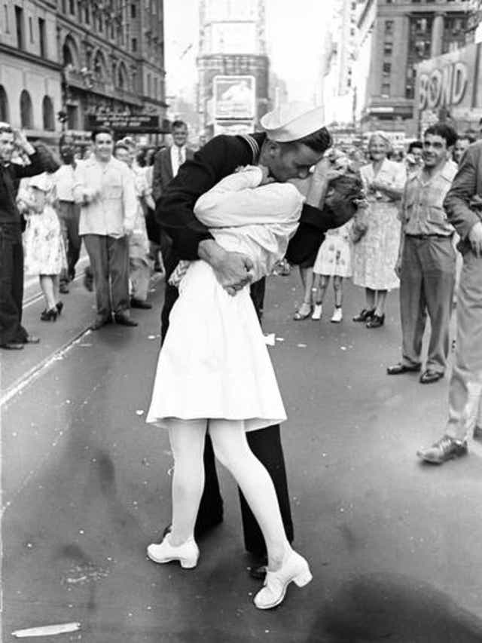
History
1950s - late 1970s
Post WWII
Materialism & Consumerism
Baby boom
Prosperity
Moving to the suburbs
Historical Events
Civil rights movement
The Cold War
Vietnam War
Women's liberation movement

Slide 4
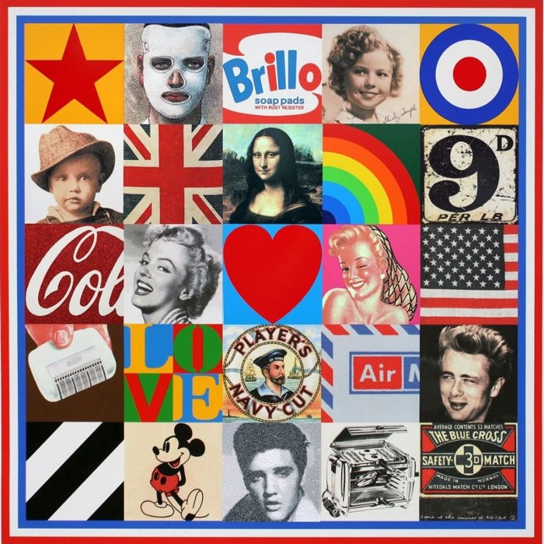
What is pop art?
Peter Blake, Sources of Pop Art 7
The “Pop” in Pop Art is in reference to the art movement being heavily influenced and frequently incorporating popular culture.

Slide 6
POp Art Characteristics
Bold, primary colours
Favored realism
Everyday/identifiable imagery
Connect the traditions of fine art with popular culture
Merging of techniques
Painting, photography, printmaking
Handmade and mass produced
Mass media
Commercial advertising methods
Silkscreening
Producing multiples - takes away the preciousness of the work
Irony and wit
Universally acceptable
Recognition of consumerism and materialism as a natural fact

Slide 7
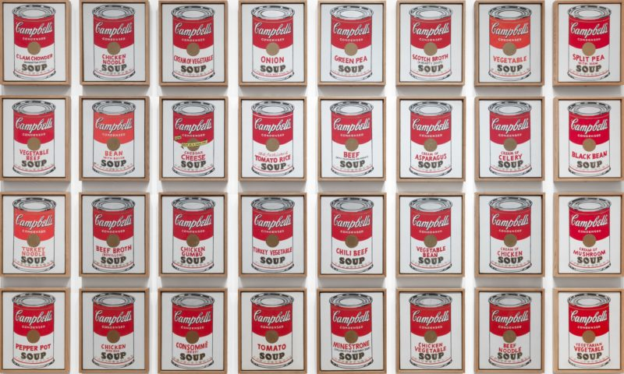
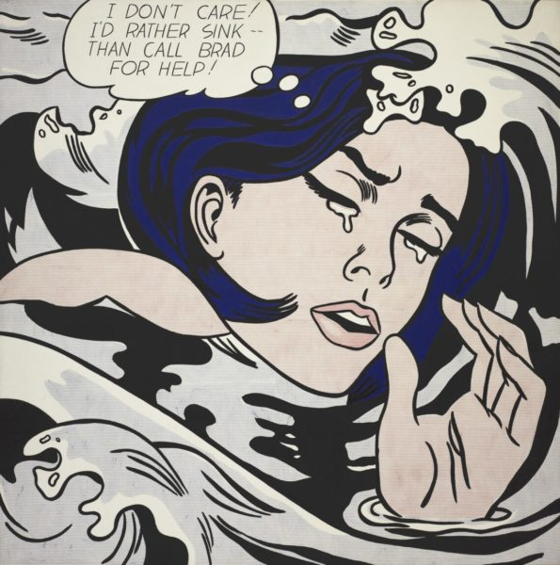
Notable artists
Andy
Warhol
Roy Lichtenstein
Campbell’s Soup 1962
Drowning Girl
1963

Slide 9
