Slide 1
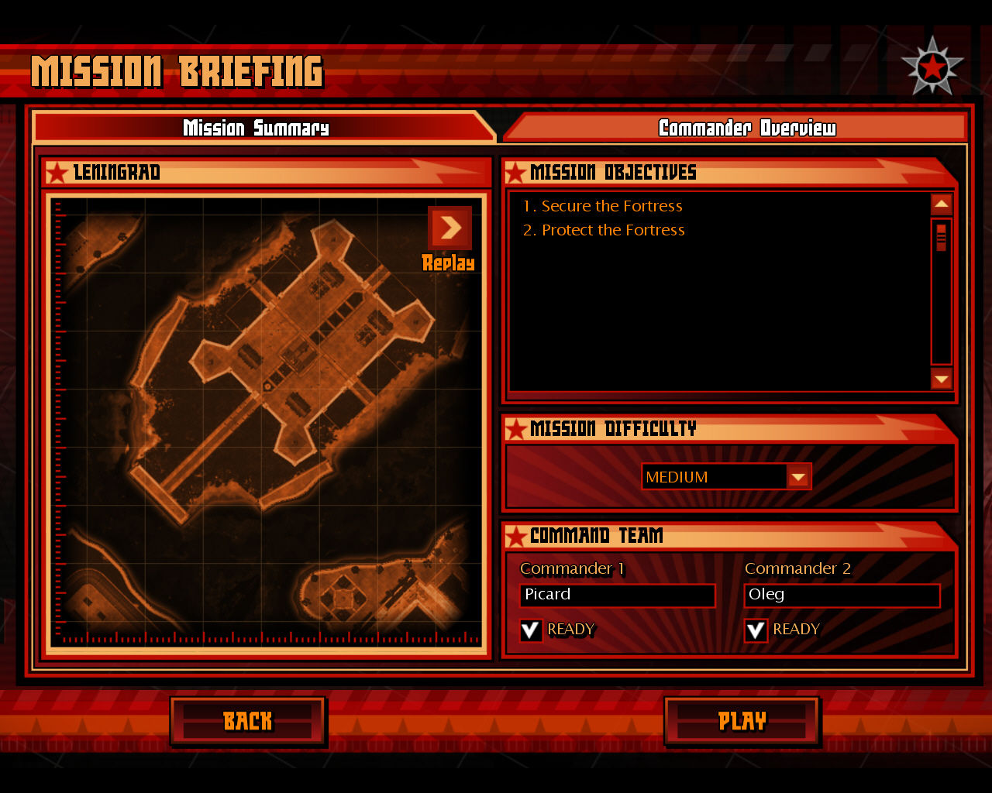
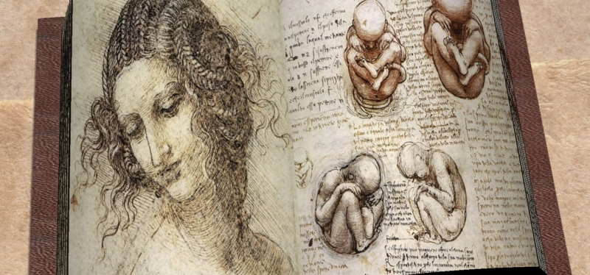
Mission Summary
Background
The 3 R’s
Visual Summary
The new ideas brought on by the Renaissance inspired new creations of all types. Some of the most amazing creators were the artists of the time. They not only painted incredible pictures but they studied science and made incredible discoveries in technology. Not just content to sit back on the classics they started to push Europe forward in new and exciting ways.
Essential Question
Who were the main artists of the Renaissance?

Slide 2
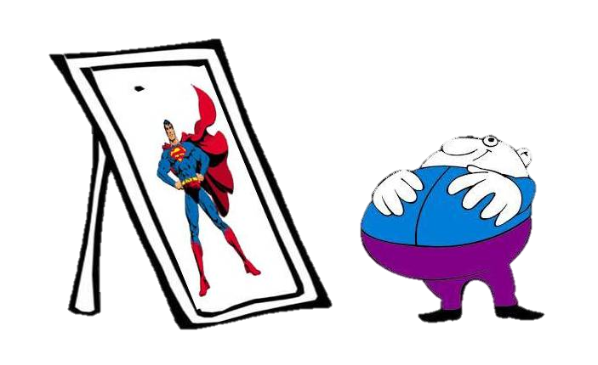
Loading...
Loading...
Loading...
Loading...
Loading...
Loading...
Loading...
One way bias happens is when we want to see only the good side of something.
Notes:
Perspective? Bias? Etc.?

Slide 3
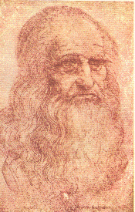
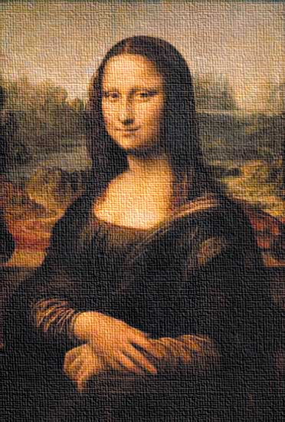
The Three Rs

Slide 4
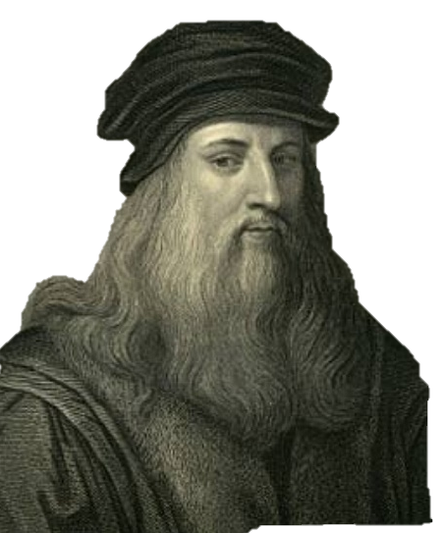
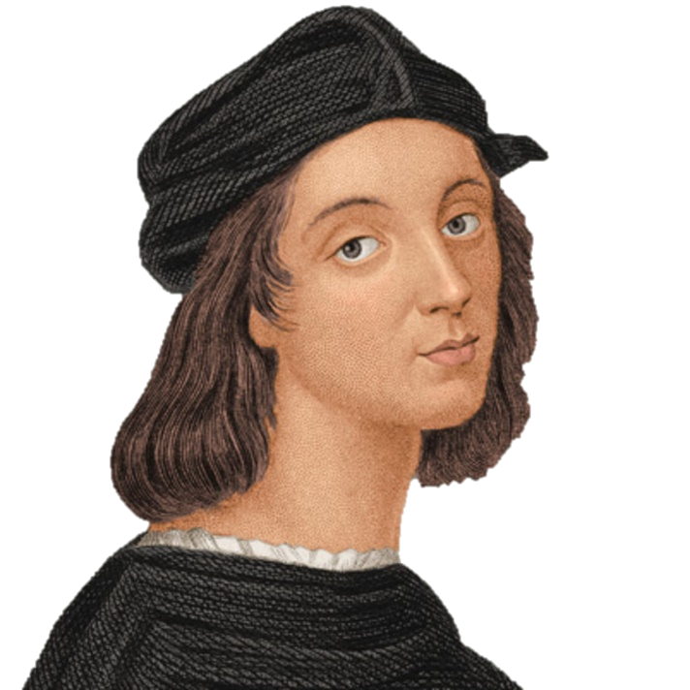
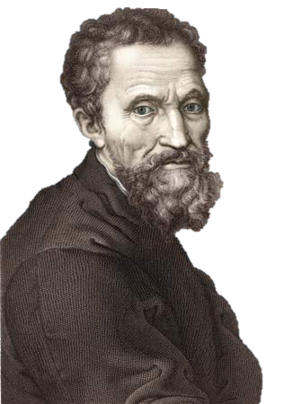
Chapter 2: The Artists
Leonardo da Vinci
Raphael da Urbino
Michelangelo di Simoni
Donatello di Sewer
Donatello di Sewer

Slide 5
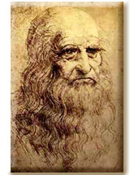
Leonardo da Vinci
Donatello di Sewer

Slide 6
Leonardo!
-OR-
Leonardon't

Slide 7
How to Play
I will show you a picture or description of something.
Tell me if you think it was invented or planned by Da Vinci or not.
Remember, Da Vinci lived in the early 1500s!

Slide 8
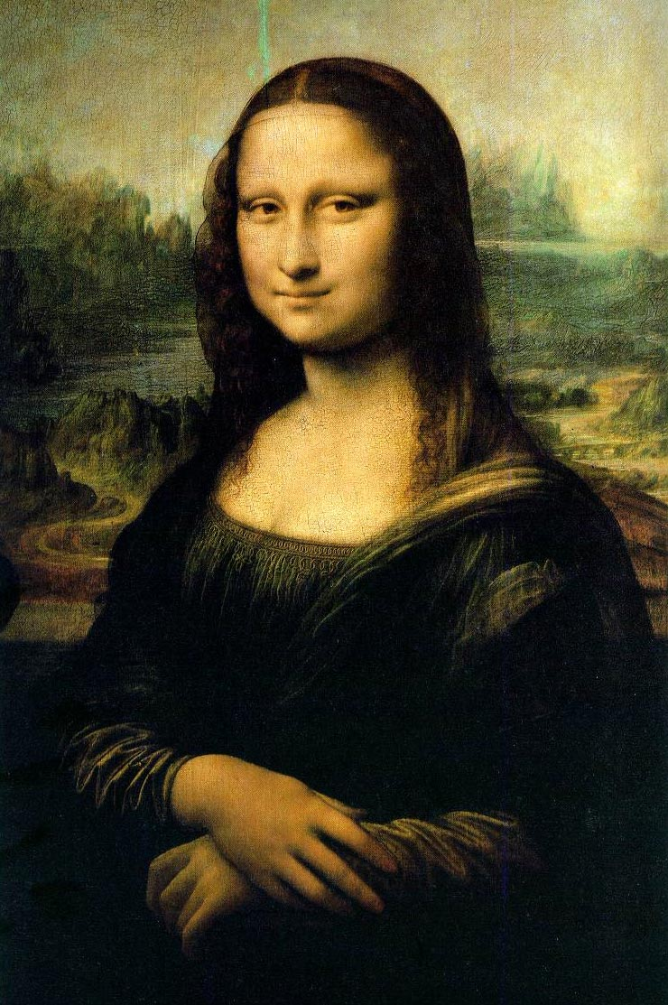
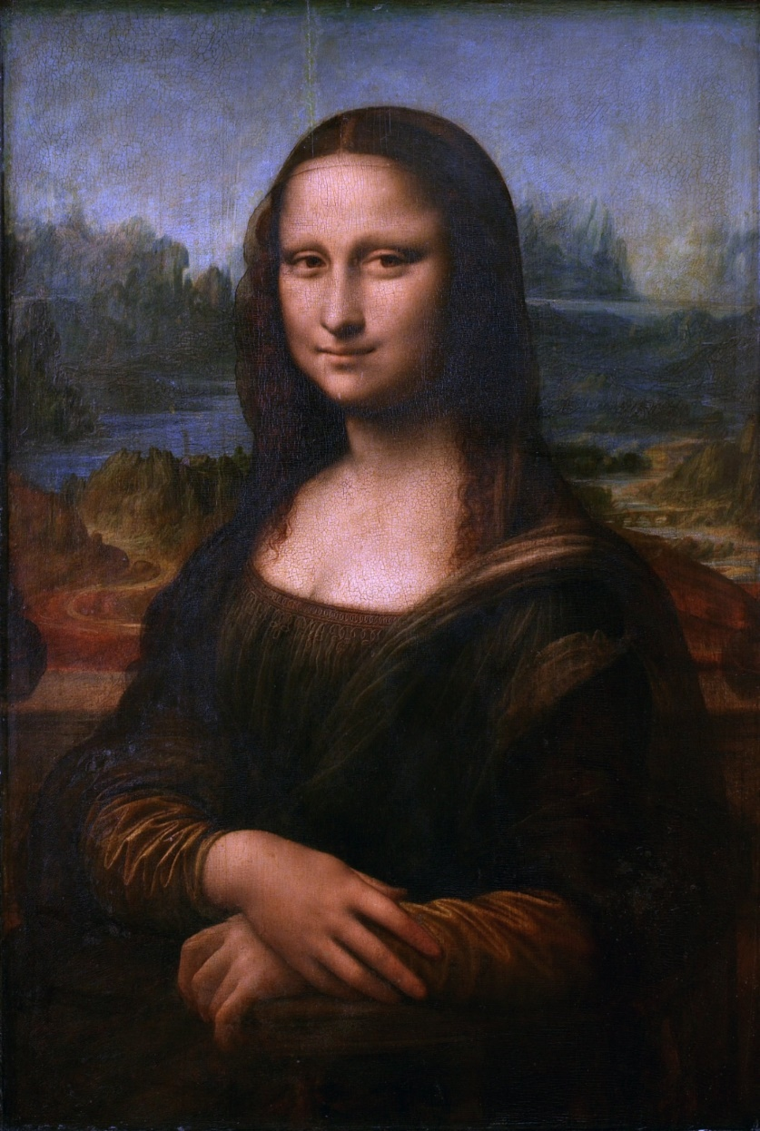
The Mona Lisa
Leonardo!
Why do you think The Mona Lisa considered such a great painting?

Slide 9
Leonardon't
The Happy Face

Slide 10
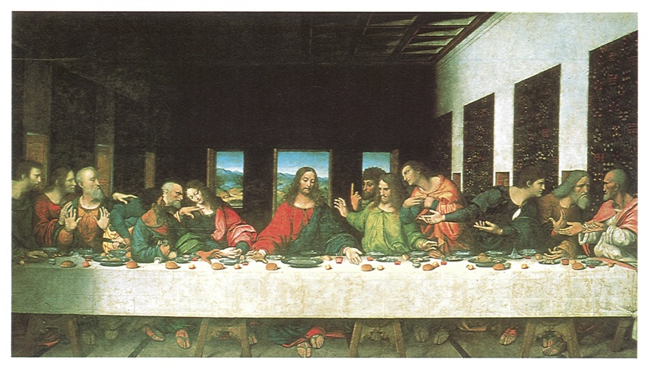
The Artist
Known for The Mona Lisa and The Last Supper.
Focused on realism, art should reflect life as it is.

Slide 11
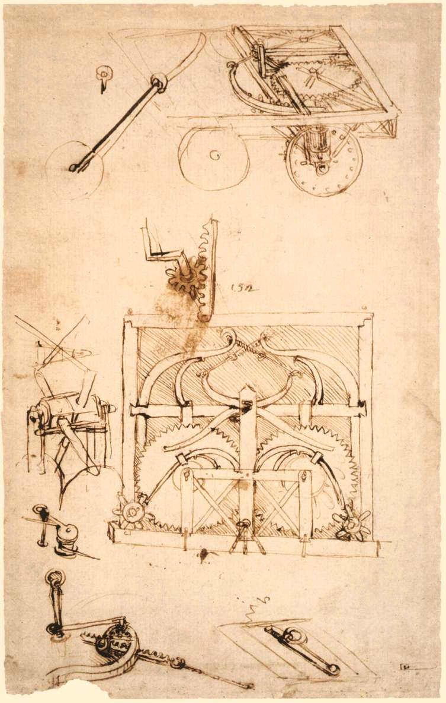
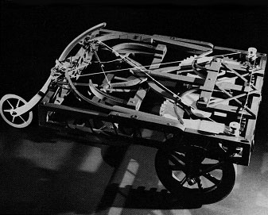
Horseless Carriage (a car)
Leonardo!

Slide 12
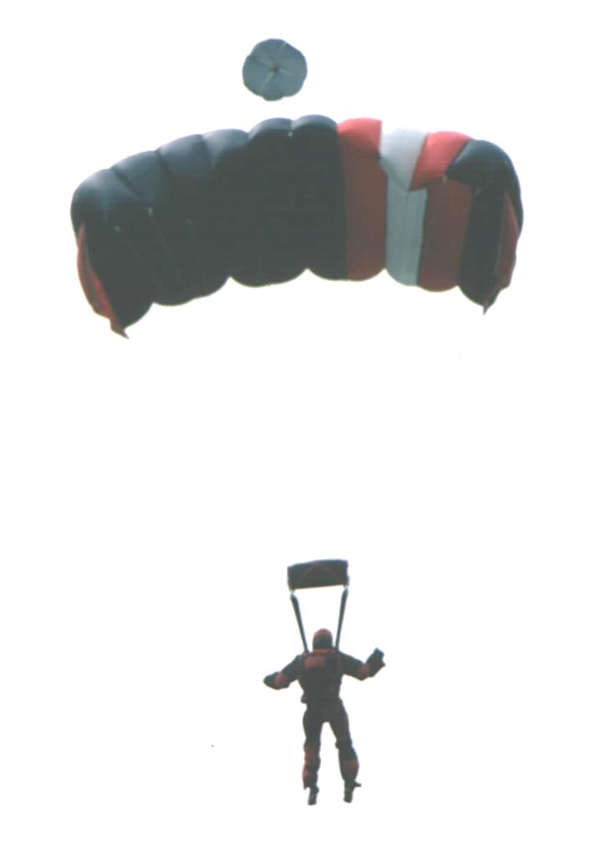
Parachute
Leonardo!

Slide 13
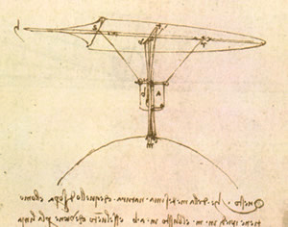
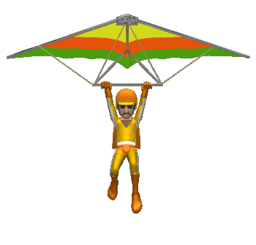
Hang Glider
Leonardo!

Slide 14
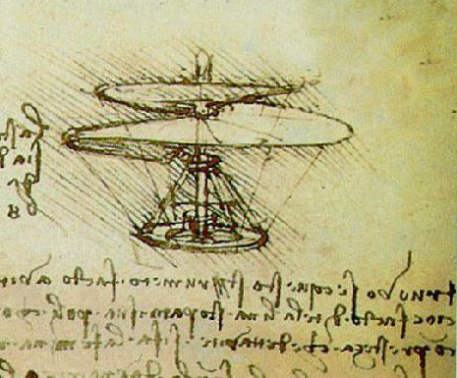
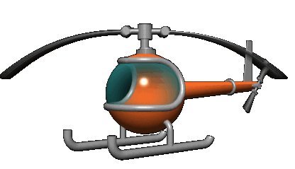
Helicopter
Leonardo!

Slide 15
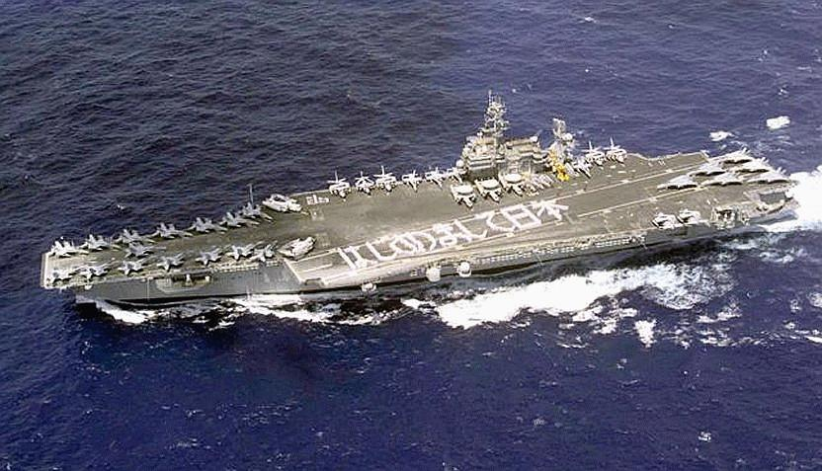
Aircraft Carrier
Leonardon't

Slide 16
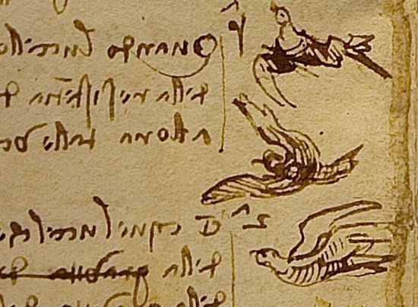
The Scientist
-He made many careful drawings of birds flying.
-He designed many types of possible flying machines, including one like a helicopter.
-Leo was very interested in flight.

Slide 17
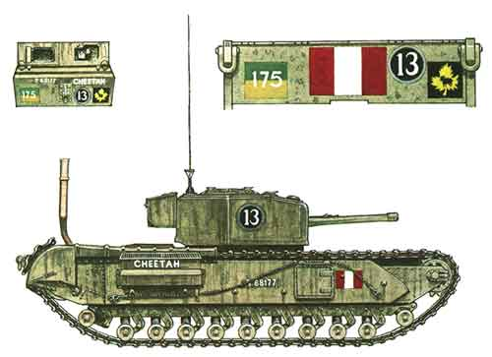
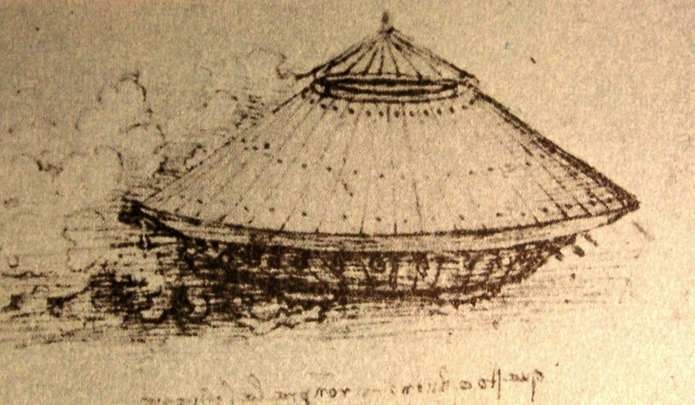
Tank
Leonardo!

Slide 18
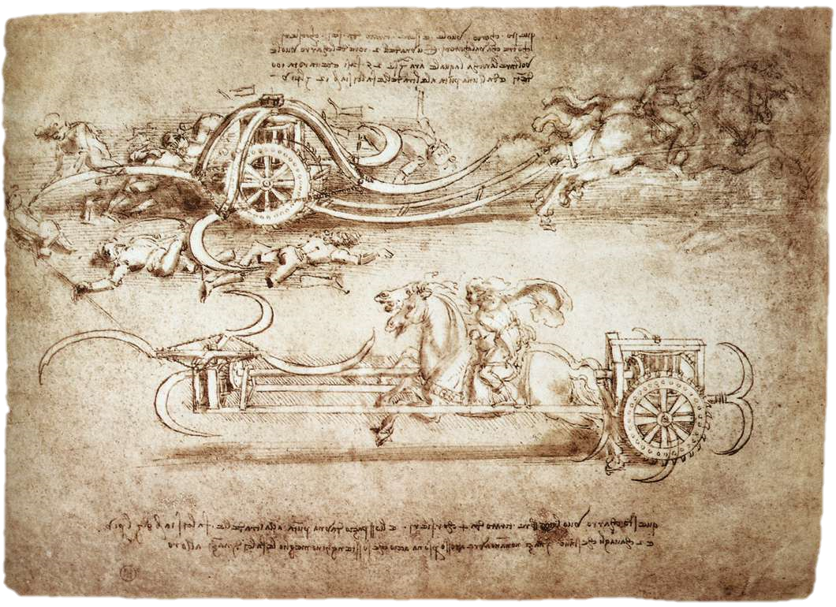
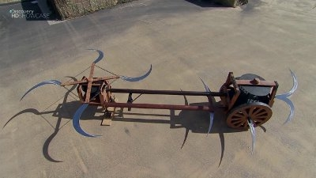
Crazy Leg Chopping Machine for Evil Geniuses
Leonardo!

Slide 19
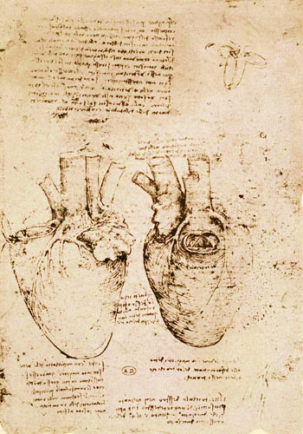
The Scientist II
-Studied the human body to make his art more lifelike.
-His sketches of bones and organs were used by doctors for hundreds of years..

Slide 20
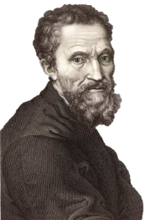
Michelangelo
Donatello di Sewer

Slide 21
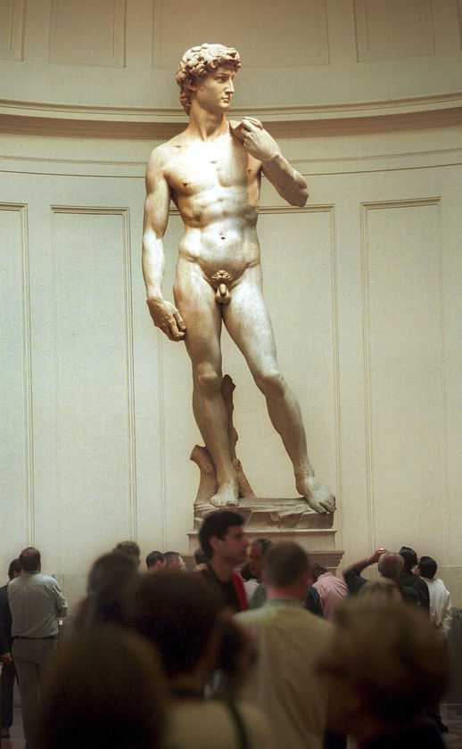
First sculpture done at age 15!
Known for the David, Moses and Pieta
Did not want to be a painter, only wanted to sculpt.

Slide 22
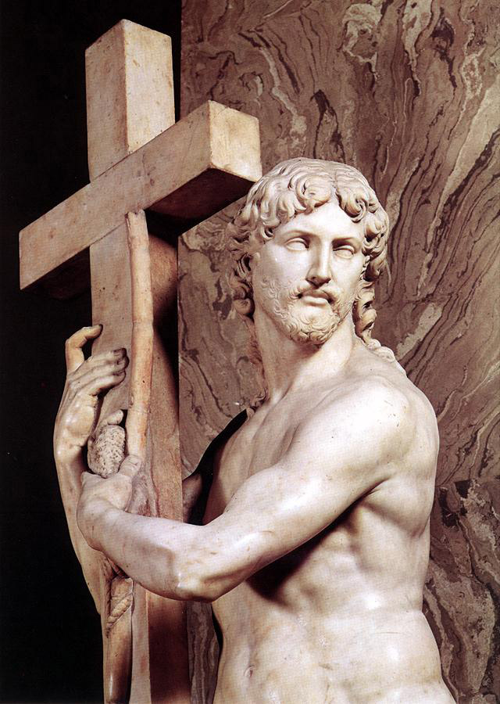
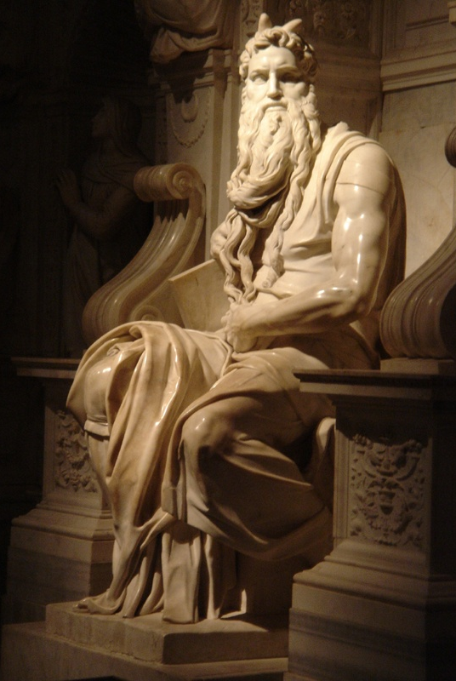

Slide 23
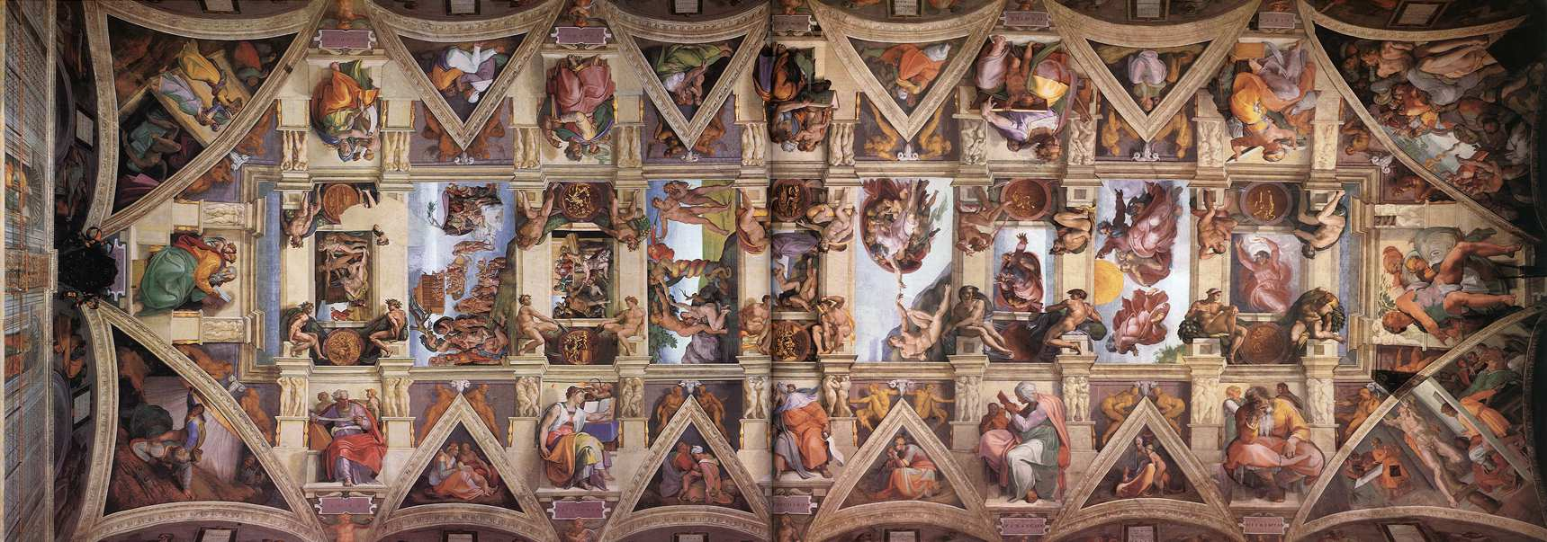
The Sistine Chapel
This is a painting on the ceiling of a church.
It took over 4 years to finish.
Michelangelo didn’t want to do it but was forced by the pope.
It wasn’t easy!

